Slide 1
Wetlands, Isolated Wetlands and Carolina Bays:
Definitions and Science
Isolated Wetlands and
Carolina Bays Task Force
September 12, 2012
Bob Perry and Johnny Stowe

Slide 2
Wetlands, Isolated Wetlands and Carolina Bays:
Definitions and Science
Presenter Qualifications
Bob Perry, Director Office of Environmental Programs, DNR
  26 years field experience working in wetland management and ecology.
  8 years administrative experience working in the permitting arena.
Johnny Stowe, Region 2 Heritage Preserve Manager, DNR
  16 years field experience managing diverse habitats protected under the South Carolina Heritage Trust Act.
  Has managed all Carolina Bays titled to DNR.

Slide 3
Wetlands, Isolated Wetlands and Carolina Bays:
Definitions and Science
Presentation Objectives
Just the Facts on Wetlands, Isolated Wetlands and Carolina Bays.
Why these Habitats and Systems are Important to the People of South Carolina.
Provide the Best Science Available for the Use of the Task Force.

Slide 4
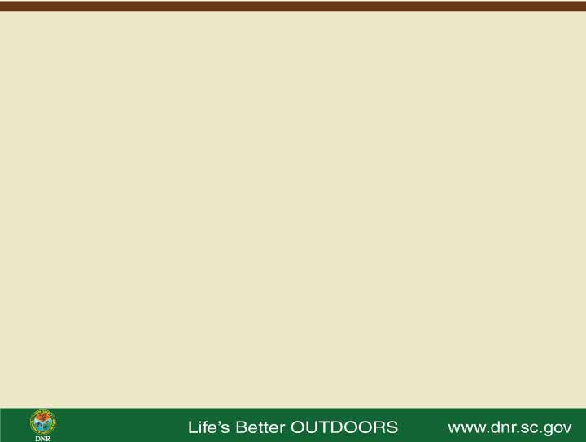
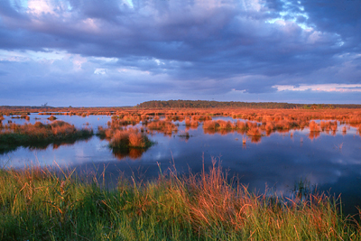
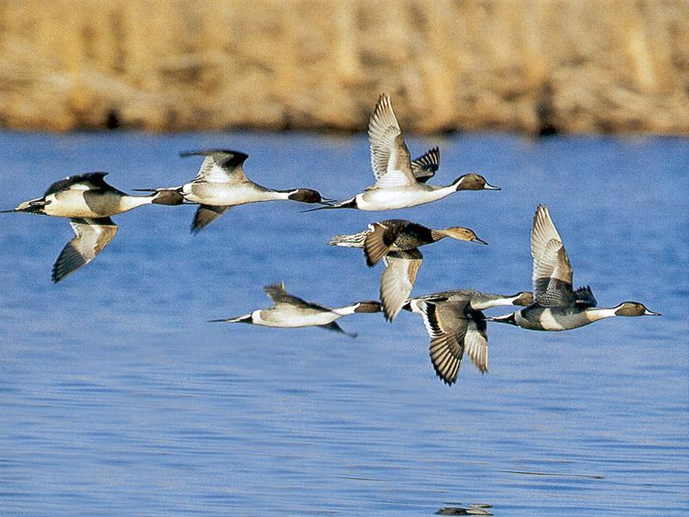
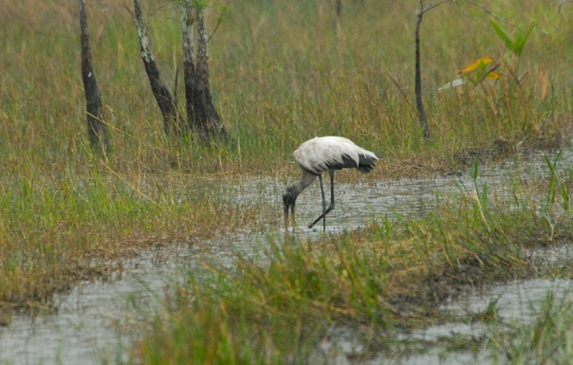
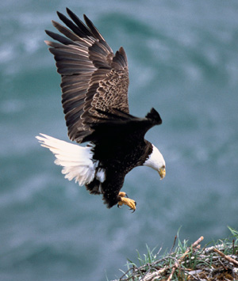
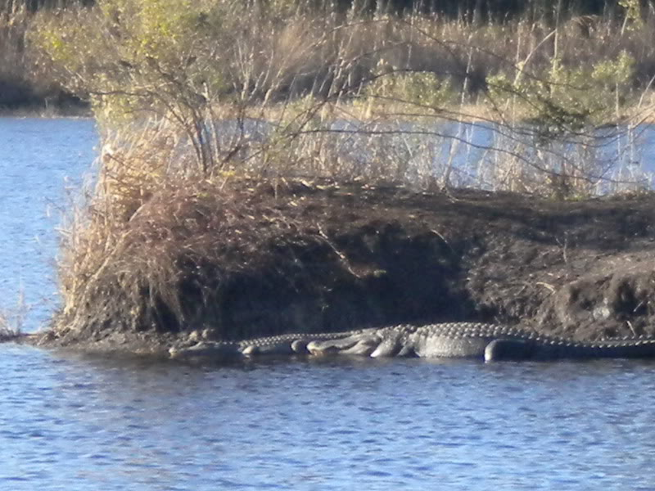
Wetlands, Isolated Wetlands and Carolina Bays: Definitions and Science
Wetlands provide a broad array of natural resource functions, recreational opportunities and considerable ecosystem services. Wetlands considered to be “jurisdictional” are protected under various regulatory mechanisms.

Slide 5
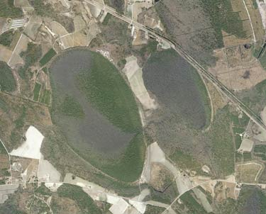
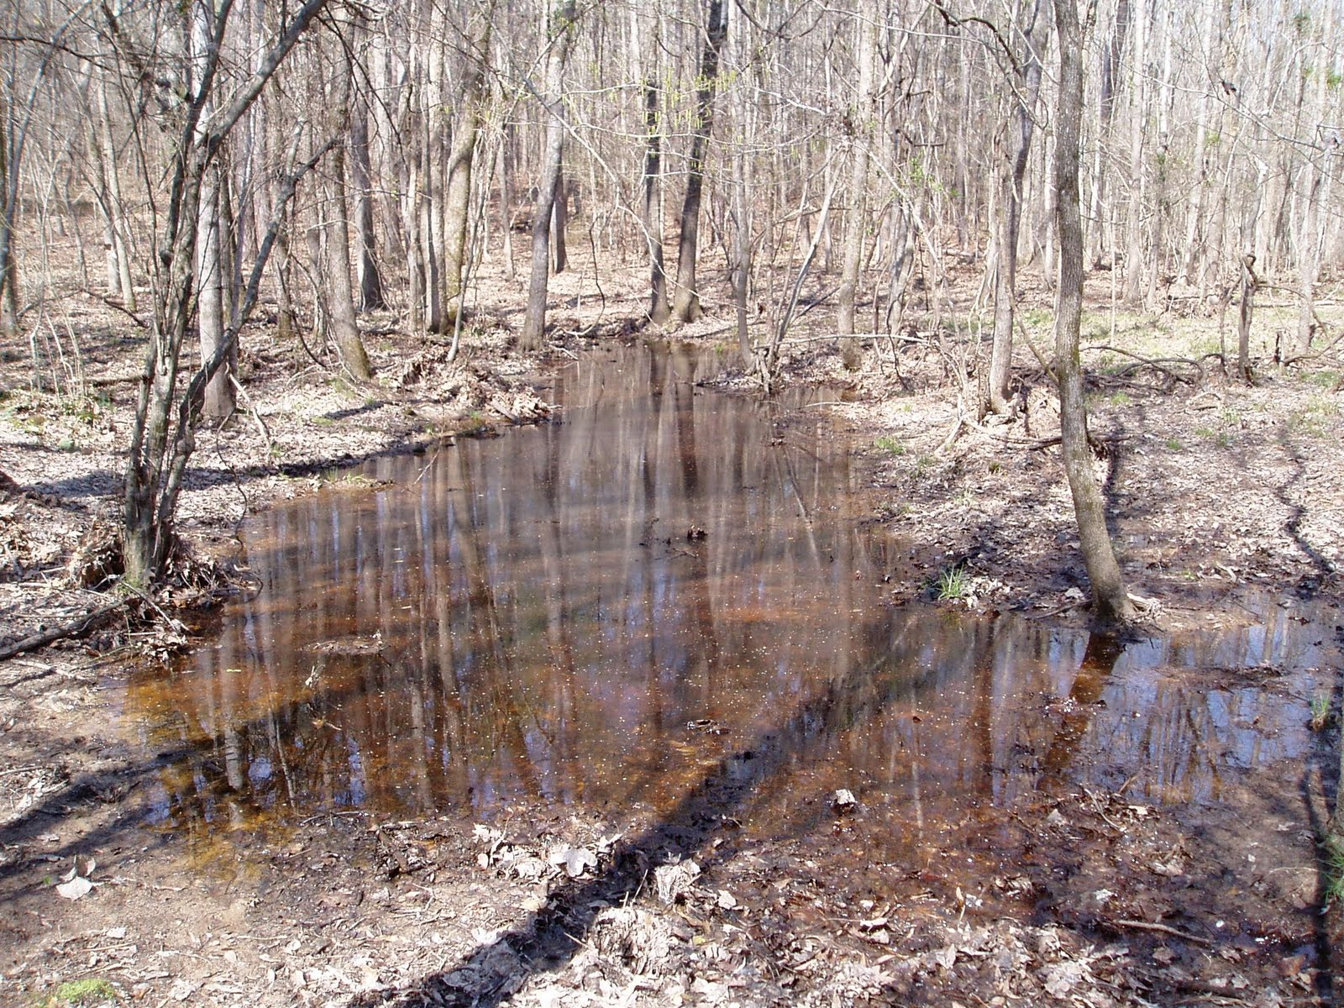
Wetlands, Isolated Wetlands and Carolina Bays: Definitions and Science
Isolated Wetland
Carolina Bays
Drew Lanham

Slide 6
Wetlands, Isolated Wetlands and Carolina Bays: Definitions and Science
Wetlands in general, are areas of land saturated with moisture seasonally or permanently taking on the characteristics of a distinct ecosystem.
Wetlands are defined as "those areas that are inundated or saturated by surface or groundwater at a frequency and duration sufficient to support, and that under normal circumstances do support, a prevalence of vegetation typically adapted for life in saturated soil conditions. Wetlands generally include swamps, marshes, bogs and similar areas." (R.61-9.122.2(b)).

Slide 7
Wetlands, Isolated Wetlands and Carolina Bays: Definitions and Science
Isolated Wetlands:
  Are a particular subset of wetlands.
  May have a perched water table or may be connected to groundwater, are fed by rainfall, but typically are not connected to another wetland or surface water.
  Are particularly important to “at risk” plant and animal species.
  May include depression meadows, high ponds, limestone sinks, pond cypress wetlands/savannahs, pond pine flatwoods and pocosins.
  May be very small or fairly large.

Slide 8
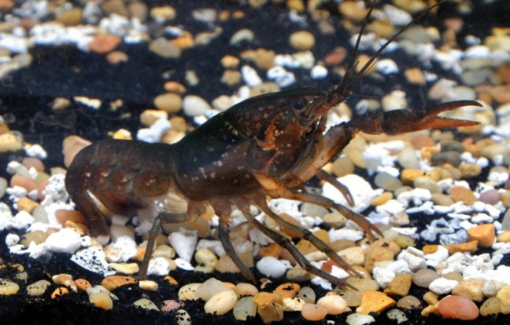
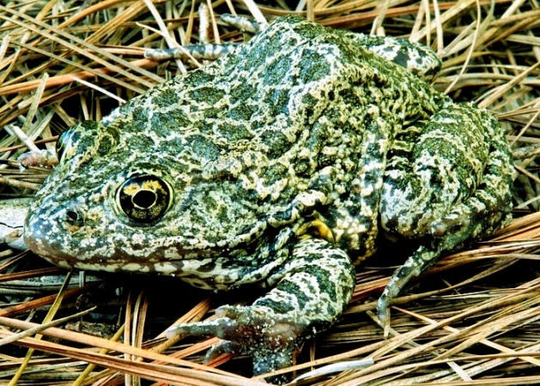
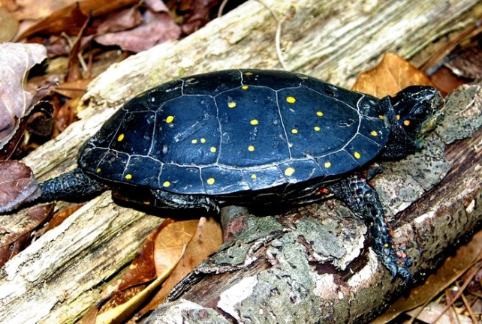
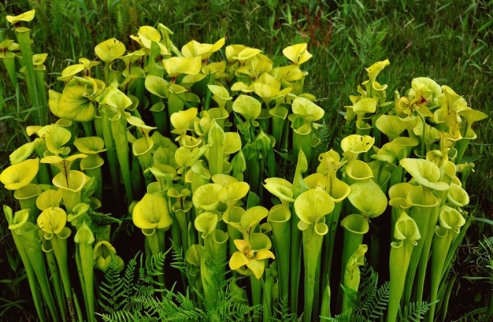
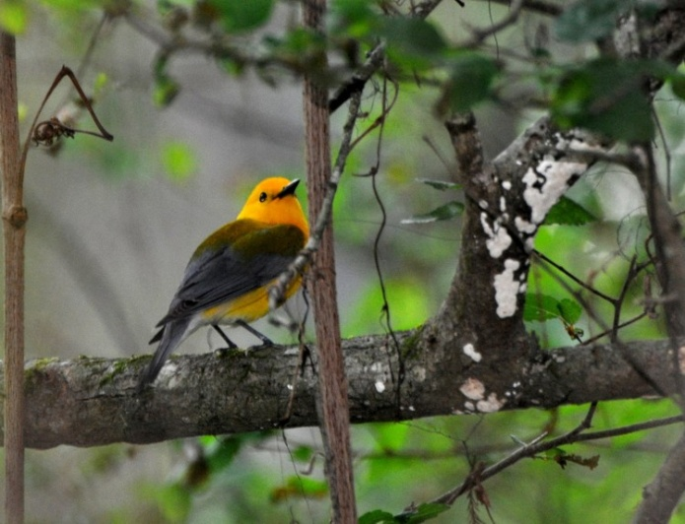
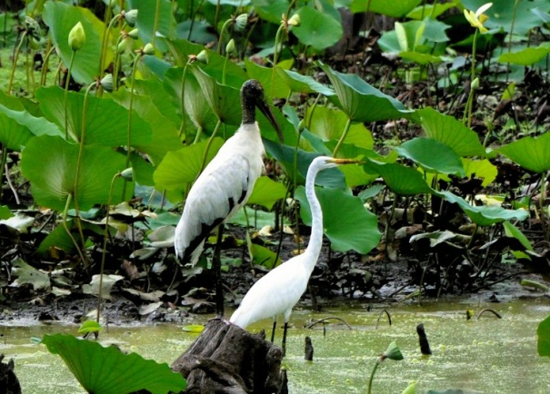
Wetlands, Isolated Wetlands and Carolina Bays: Definitions and Science
Isolated Wetlands are Important for Hundreds of Species of Plants and Animals in South Carolina. Many of these Species Have Been Identified as “At Risk.”

Slide 9
Wetlands, Isolated Wetlands and Carolina Bays: Definitions and Science
Carolina Bays, a Distinct Type of Isolated Wetlands:
  Are shallow, poorly drained, elliptical depressions characterized by features which may be shared with other isolated wetlands. Features may include:
    Elliptical or oval shape,
    Northwest-southeast orientation,
    Parallel axes,
    Interior surfaces below general level
    Sand rims above general level,
    Differences between interior and exterior soils,
    Relatively shallow depths,
    Flat, sandy bottoms beneath interior fill,
    Independence of any stream connections, and
    Bays often overlap, and there are some bays within bays.

Slide 10
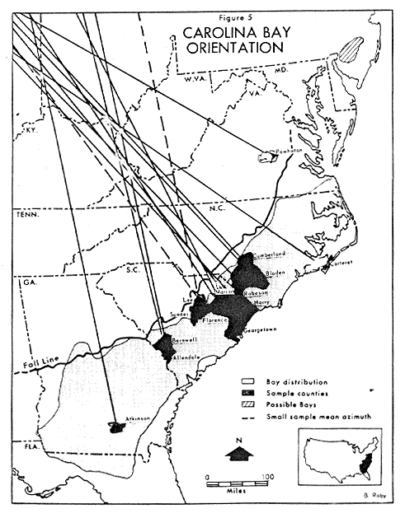
Wetlands, Isolated Wetlands and Carolina Bays: Definitions and Science
Carolina bays geographically are located from New Jersey to North Florida and are most common in the Carolinas.
It is estimated there may be as many as 2,600 Carolina Bays in South Carolina.
Up to 97% of the Carolina Bays in South Carolina have been disturbed or impacted in some way.

Slide 11
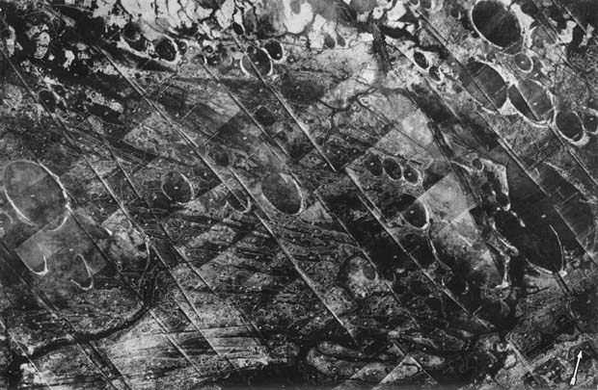
Wetlands, Isolated Wetlands and Carolina Bays: Definitions and Science
Distribution of Carolina Bays as Recorded by Early Aerial Photography

Slide 12
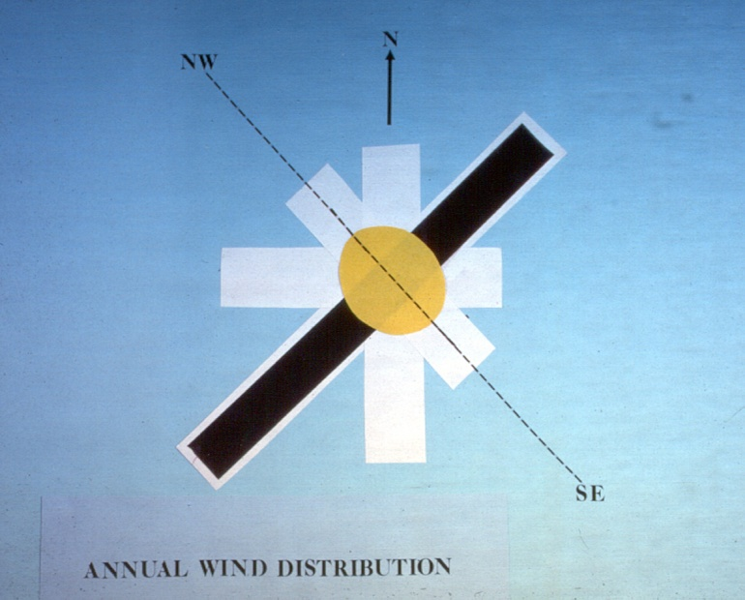
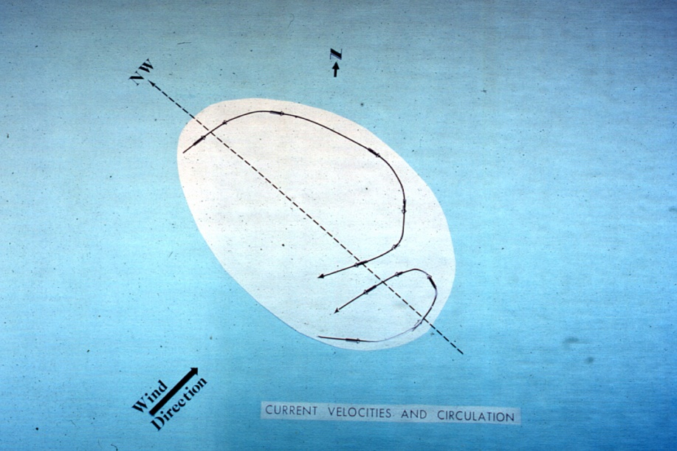
Wetlands, Isolated Wetlands and Carolina Bays: Definitions and Science
Carolina Bays may be the results of shallow lakes formed after the ocean receded from the Coastal Plain.
Once created, these small lakes continued to expand through wind and wave motions, creating these uniform ovals.
Orientation therefore lies in the plane affected for the longest period by wind and wave action.
Wind may be responsible for the deposition of sand rims.

Slide 13
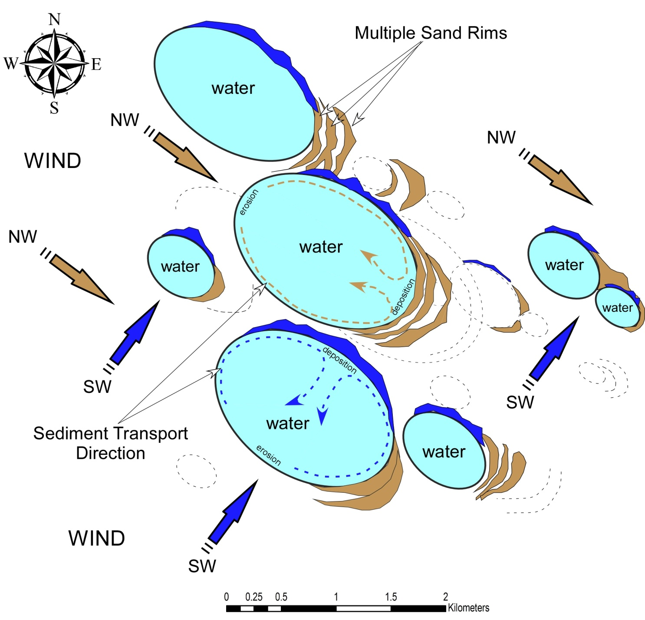
Wetlands, Isolated Wetlands and Carolina Bays: Definitions and Science
Carolina
Bays,
a Distinct
Type
of Isolated
Wetlands:

Slide 14
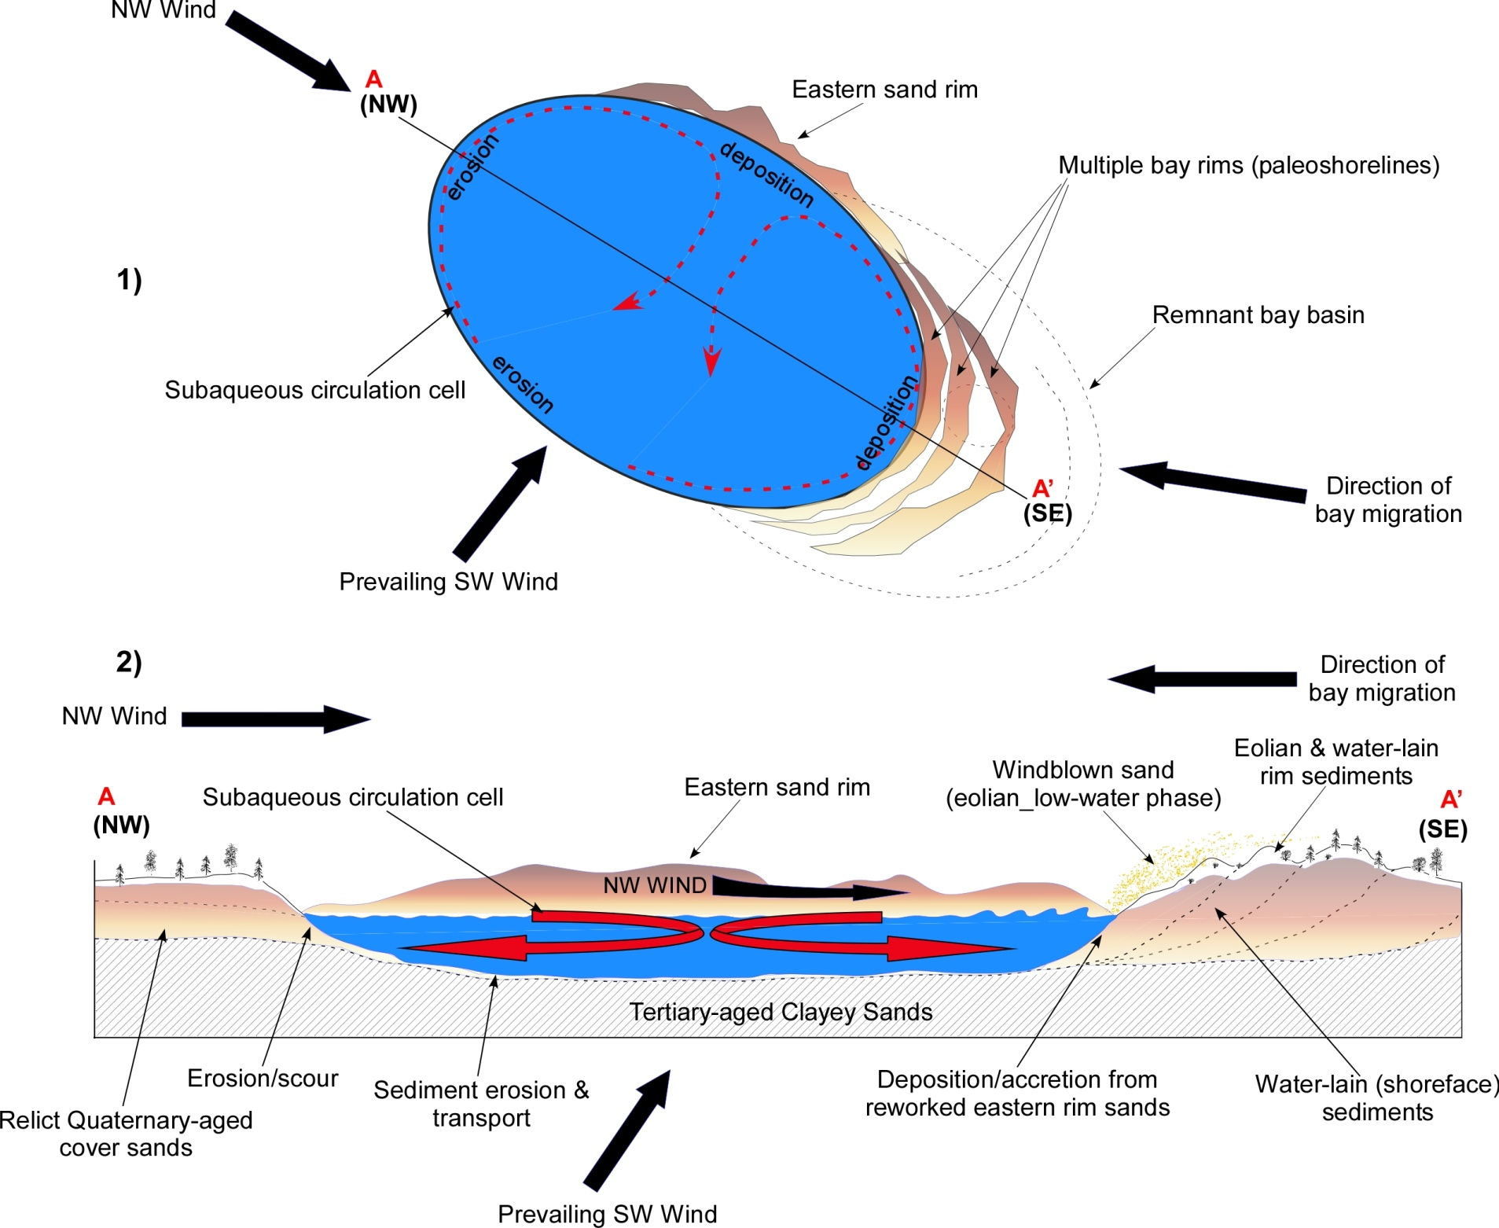
Wetlands, Isolated Wetlands and Carolina Bays: Definitions and Science
Carolina
Bays,
a Distinct
Type
of Isolated
Wetlands:

Slide 15
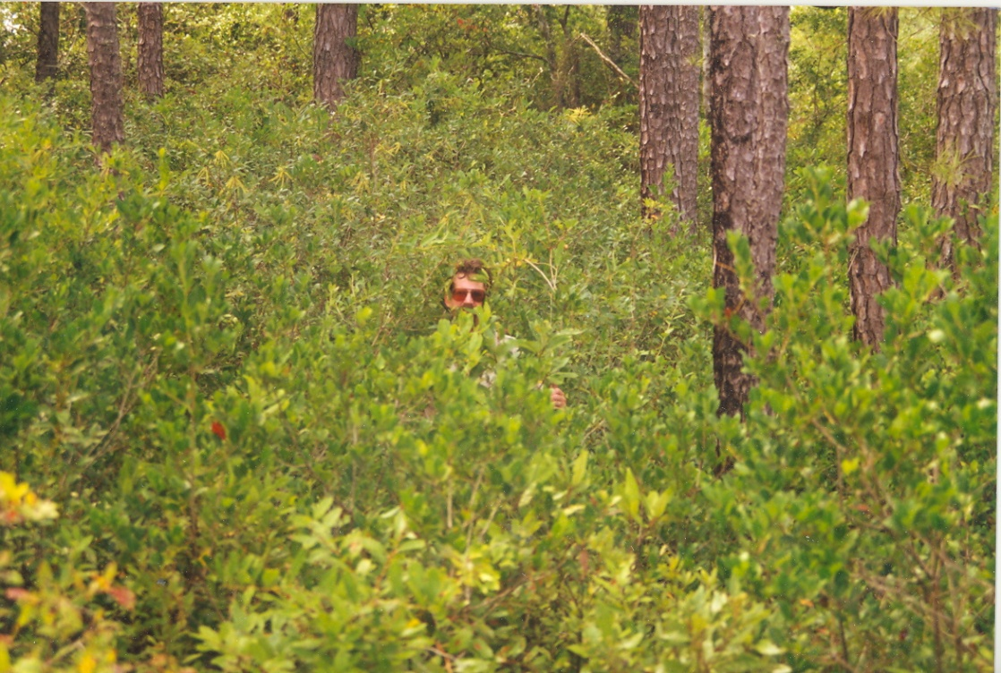
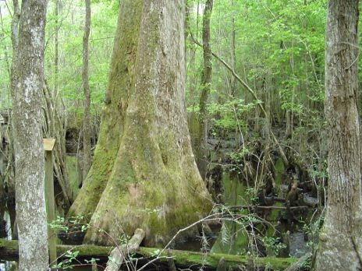
Wetlands, Isolated Wetlands and Carolina Bays: Definitions and Science
Vegetation extremes can occur across and within Carolina Bays depending on various biotic and abiotic factors.

Slide 16
Wetlands, Isolated Wetlands and Carolina Bays: Definitions and Science
Ecosystem Services: All wetlands provide important functions often termed “ecosystem services.”
  These functions include the many life-sustaining benefits we receive from nature – clean air and water, fertile soil for crop production, pollination, and flood control.
  Ecosystem services are important to human health and well-being.
  Ecosystem services are limited and often taken for granted because they are free.

Slide 17
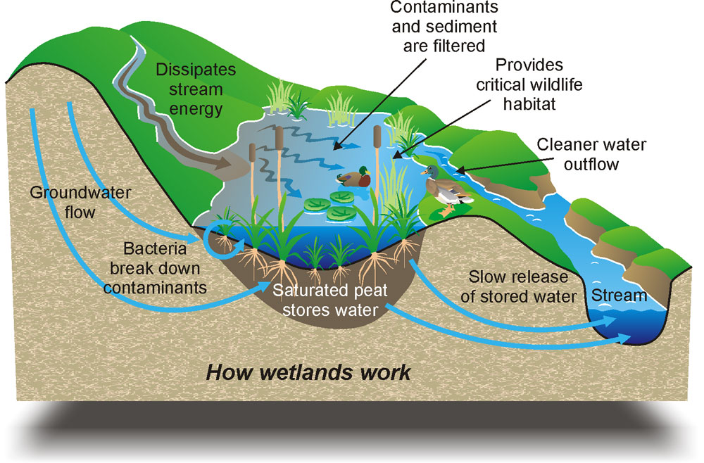
Wetlands, Isolated Wetlands and Carolina Bays: Definitions and Science
Ecosystem Services – Wetlands Are Worth Billions!
Food & Fresh Water
Cleans the Air
Flood Attenuation
Sediment Retention
Assimilation of Pollutants
Pest Regulation
Nutrient Recycling
Carbon Storage
Aesthetic Values
Ecotourism & Recreation
Provides Jobs
More!!!

Slide 18
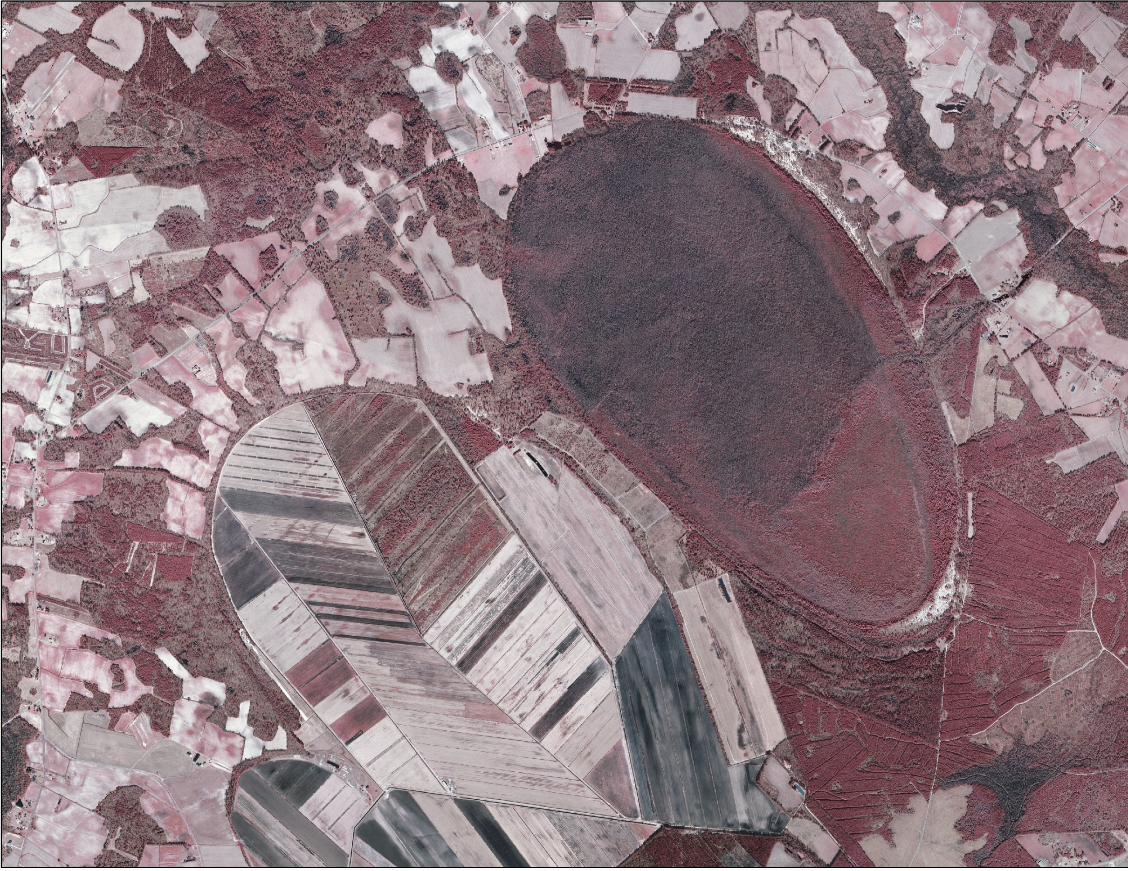
Wetlands, Isolated Wetlands and Carolina Bays: Definitions and Science
Diles Bay and Woods Bay near Turbeville: A contrast in land use practices.

Slide 19
Wetlands, Isolated Wetlands and Carolina Bays: Definitions and Science
References:
Bennett, S. H., and J. B. Nelson. 1991. Distribution and Status of Carolina Bays in South Carolina. SCDNR Heritage Trust.
Hilton, B. 1992. Isolated Wetlands. Wetlands … Magic Lands (Special Issue of
South Carolina Wildlife Magazine.). SCDNR. 39:1. 78.
Savage, H. 1982. The Mysterious Carolina Bays. Univ. of South Carolina Press.
Semlitsch, R.D., and J.R. Bodie. 1998. Are Small, Isolated Wetlands Expendable? Conservation Biology. 12(5):1129-1133.
Sharitz, R.R., and J.W. Gibbons. 1982. The Ecology of Southeastern Shrub bogs (Pocosins) and Carolina Bays: A Community Profile. U.S. Fish and
Wildlife Service. FWS/OBS-82-04.

Slide 20
Wetlands, Isolated Wetlands and Carolina Bays: Definitions and Science
References:
Sharitz, R.R. 2003. Carolina Bay Wetlands: Unique Habitats of the Southeastern United States. Wetlands. 23(3):550-562.
Watts, W. A. 1980. Late-Quaternary Vegetation History at White Pond on the Inner Coastal Plain of South Carolina. Quaternary Research 13:187-199.
Winter, T.C., and J.W. Labaugh. 2003. Hydrologic Considerations in Defining Isolated Wetlands. Wetlands. 23(3):532-540.

Slide 21
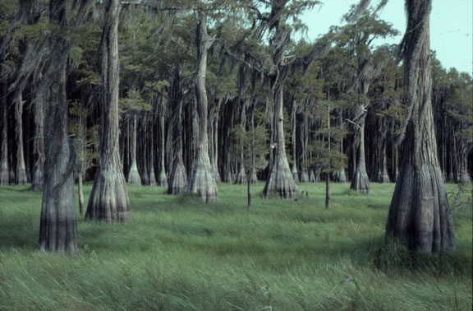
Wetlands, Isolated Wetlands and Carolina Bays: Definitions and Science
Questions?

